Slide 1
EventHub
Damir Dobric damir.dobric@daenet.com https://developers.de/author/ddobric
daenet Lead Software Architect Microsoft Regional Director & Most Valuable Professional
Blog:
Monday
15.00-16.30
16.45-17.30
Twitter:
https://twitter.com/ddobric

Slide 2
Agenda
Messaging (Dist. Systems
Integration)
Streaming
( IoT )

Slide 3
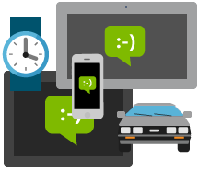
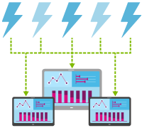
The problem?
Connect millions of devices across platforms
Stream millions of events per second into multiple applications

Slide 4
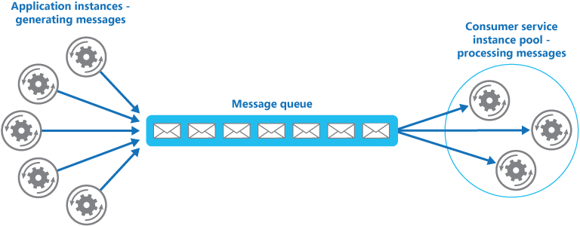
Competing Consumer
Queues and topics use a Competing Consumer model in which each consumer attempts to read from the same queue or resource.
This competition for the resource ultimately results in complexity and scale limits for processing of streaming messages.

Slide 5
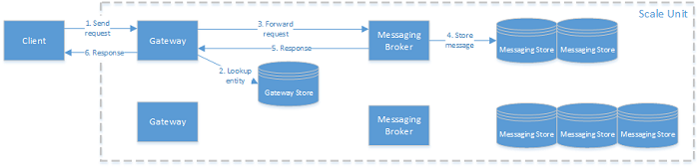
Bus Architecture

Slide 6
Bus Architecture (Scale Unit) Example: Azure Service Bus
A set of gateway nodes. Gateway nodes authenticate incoming requests and handle relay requests. Each gateway node has a public IP address.
A set of messaging broker nodes. Messaging broker nodes process requests concerning messaging entities.
A set of notification nodes. Notification nodes send push notifications to all registered devices.
One gateway store. The gateway store holds the data for every entity that is defined in this scale unit. The gateway store is implemented on top of Azure Storage.
Many messaging stores. The messaging stores hold the messages of all queues, topics and subscriptions that are defined in this scale unit. It also contains all subscription data. Unless Partitioning Messaging Entities is enabled, a queue or topic is mapped to one messaging store. Subscriptions are stored in the same messaging store as their parent topic. The messaging stores are implemented on top of SQL Azure databases.
Multiple registration stores. The registration stores contain device registrations for all notification hubs that are defined in this scale unit. The registration stores are implemented on top of SQL Azure databases
https://msdn.microsoft.com/en-us/library/azure/dn459033.aspx

Slide 7

Routing
With huge number of messages and clients, this route (architecture) can become a bottleneck.
mynamespace.azureservicebus.net/myqueue
mynamespace.azureservicebus.net/myqueue/mysubqueue
All messages sent to same queue (and subqueues) re allways routed to same gateway, broker and DB.

Slide 8
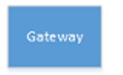
Partitioning
P1
P2
P3

Slide 9
How to enable partitioning?
NamespaceManager ns = NamespaceManager.CreateFromConnectionString(myConnectionString); TopicDescription td = new TopicDescription(TopicName);
td.EnablePartitioning = true; ns.CreateTopic(td);

Slide 10
How to send to partition?
Messages with same KEY are routed to the same partition.
BrokeredMessage msg = new BrokeredMessage("This is a message"); msg.PartitionKey = "myPartitionKey"; messageSender.Send(msg); ts.Complete();
If you don’t set partition key, system will partition randomly.

Slide 11
Receiving from Partition
Client does not know anything about partitions. No specific code required.
Broker (Server) gets messages from all partitions (saves them in cache) and return the first received message.
Messages or disordered
When using sessions message SessionId is used as Partition Key. All messages within same session share same partition. When reading from same partition messages are ordered if session enabled.

Slide 12
But?
You can scale out with partitioning as long nobody else use the Scale Unit!
For Example: If you have multiple tenants (many clients), which also use same partitions you will get the same problem as without partitions.
Do we need some other approach?!

Slide 13
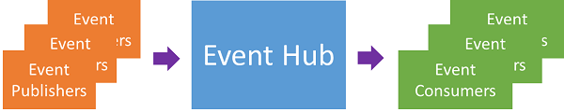
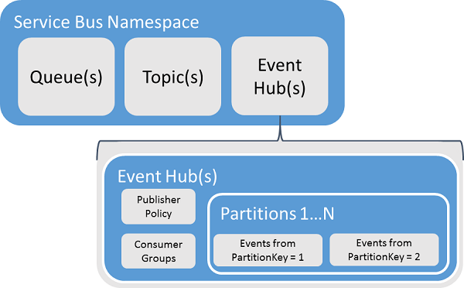
EventHubs

Slide 14
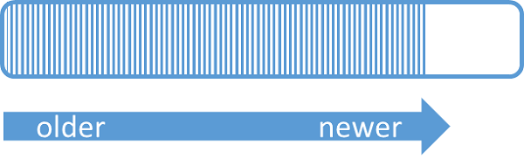
Streaming
Event Hubs provides message streaming support.
What is stream?
http://www.programcreek.com/2014/01/what-is-stream/

Slide 15
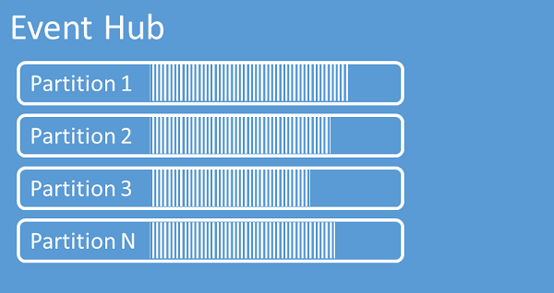
Partitioning
Event Hubs uses a partitioned consumer pattern (not competing pattern) in which each consumer only reads a specific subset, or partition, of the message stream.
This pattern enables tremendous horizontal scale for event processing and provides other stream-focused features that are unavailable in queues and topics.

Slide 16
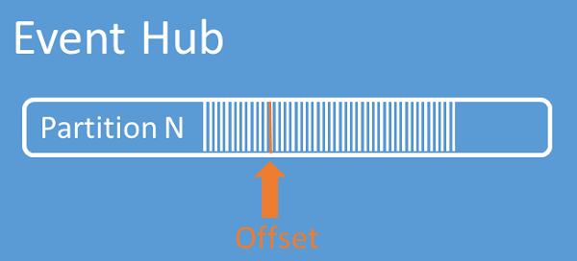
Offset
An offset is the position of an event within a partition.
Offset is some kind of client-side cursor.
The offset is a byte numbering of the event.
This enables an event consumer (reader) to specify a point in the event stream from which they want to begin reading events.
You can also specify the offset as a timestamp or as an offset value.
Consumers are responsible for storing their own offset values outside of the Event Hubs service.

Slide 17
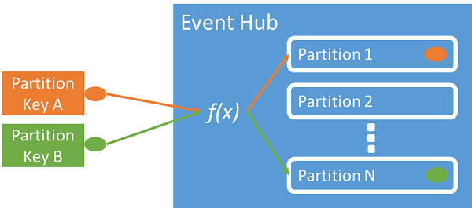

Publishing Events
Publishers send continuously events (messages) to hub.
EventData data = new EventData(info, serializer) { PartitionKey = info.DeviceId.ToString() }; Properties.Add("Type", "Telemetry_" + DateTime.Now.ToLongTimeString()); } await client.SendAsync(data);

Slide 18
Consuming Events
Two ways of consuming events
Direct Consumer
EventProcessorHost

Slide 19
Direct Consumer
EventHubConsumerGroup group = client.GetDefaultConsumerGroup();
var receiver = group.CreateReceiver(client.GetRuntimeInformation().PartitionIds[0]);
bool receive = true; string myOffset; while(receive) { var message = receiver.Receive(); myOffset = message.Offset; string body = Encoding.UTF8.GetString(message.GetBytes()); Console.WriteLine(String.Format("Received message offset: {0} \nbody: {1}", myOffset, body)); }

Slide 20
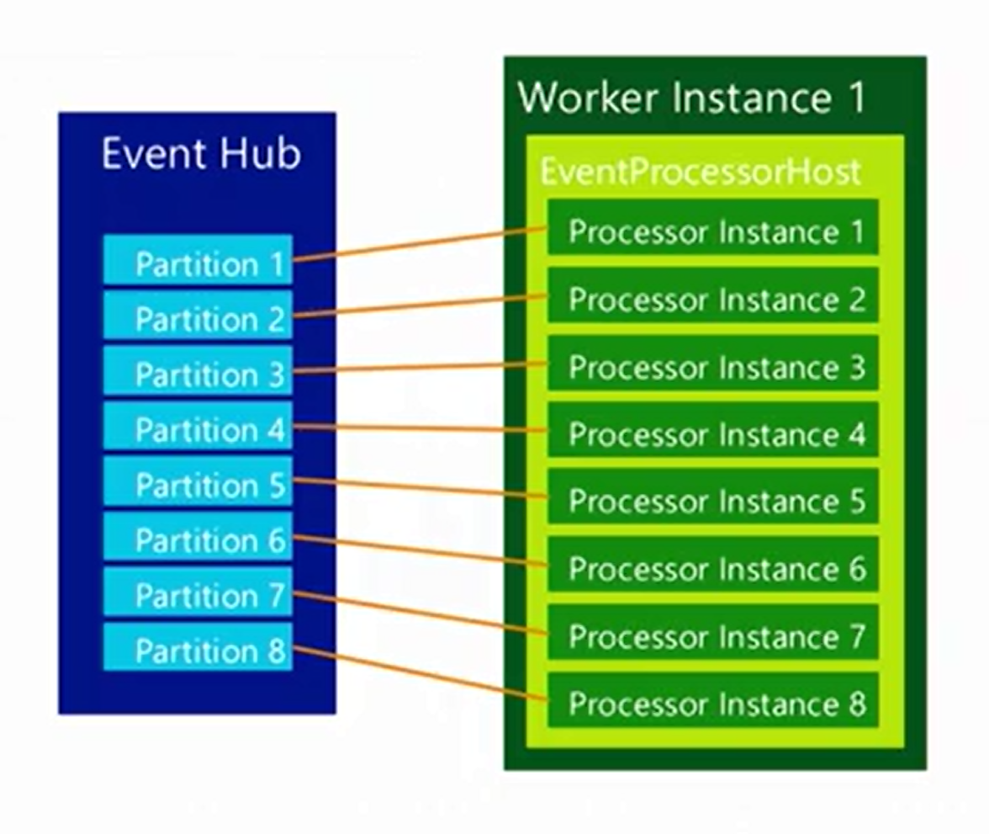
EventProcessorHost
one processor instance (consumer) per partition!
No competing consumers!

Slide 21
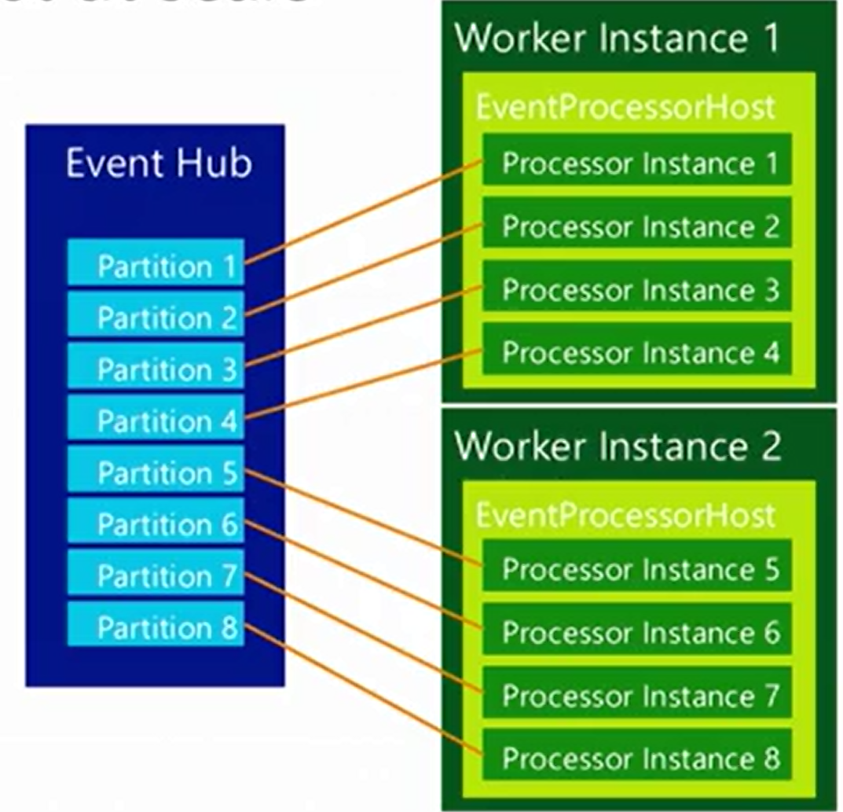
EH with Multiple “Workers”

Slide 22
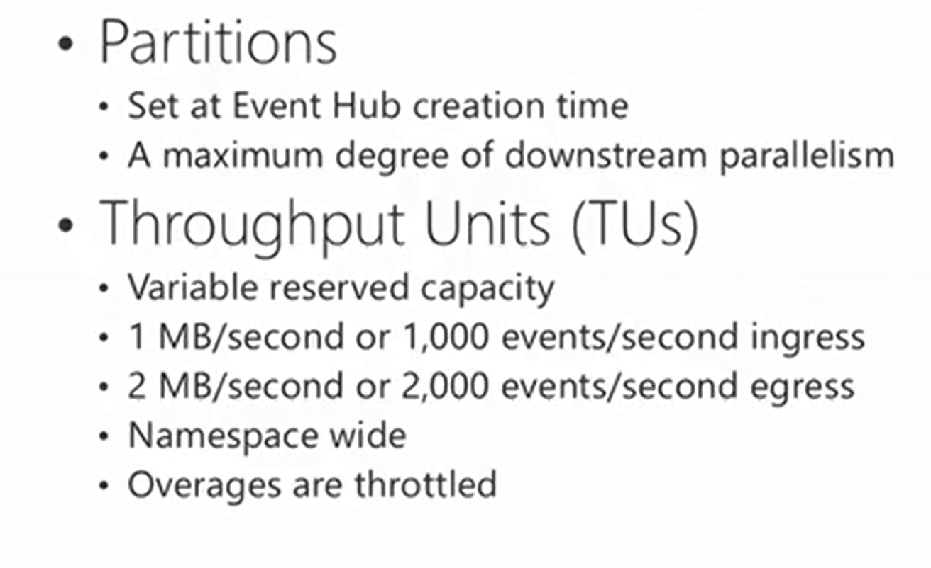
Partitions and TUs

Slide 23
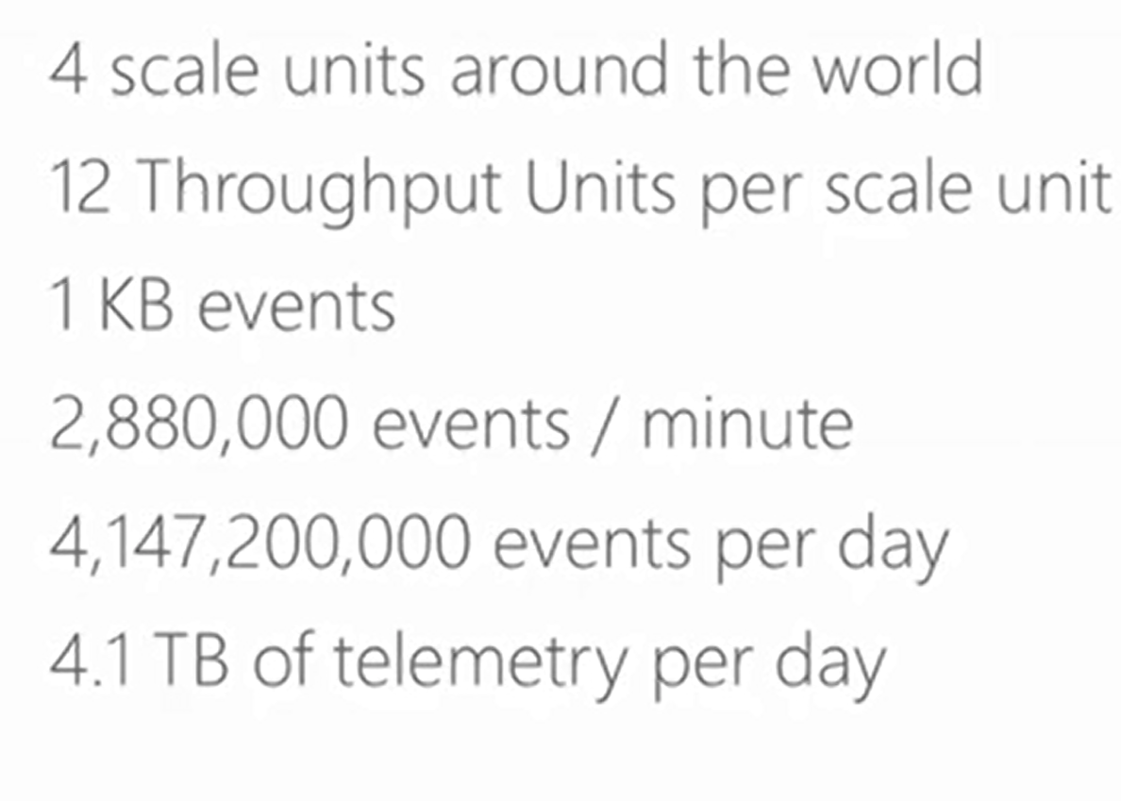
How much can we scale?
12*4*1000*60=2 880 000
2 880 000 * 60 *24 = 4147200000

Slide 24
Azure Portal How to start?
https://docs.microsoft.com/en-us/azure/event-hubs/event-hubs-quickstart-portal

